Slide 1
An Introduction to Formal Languages
史晓东 (Mandel)
mandel@xmu.edu.cn

Slide 2
Outline
Basic concepts of Formal Languages
  Vocabulary, string, sentence, language
Chomsky hierarchy
parse tree
A very short introduction to parsing by nltk
discussion on grammars and languages
Summary

Slide 3
Basic concepts of Formal Languages
字母表Σ：符号的有限集合，
例： ∑ = {0,1} for binary numbers
∑ = {a,b,c,...x,y,z} the English alphabet
串：字母表上的符号的有穷序列，
例：0110, great，abba
ε is a special string denoting no symbols. It is called the empty (null) string

Slide 4
String Operations
  Concatenation 连接 xy，sε = εs = s
  power 幂（exponentiation 求幂）s⁰为ε，s^{i}为s^{i-1}s（i > 0）
  reverse:
  w = abc
  w^{R} = cba
  length: w = a₁a₂...a_{n}
  |w| = n
  |ε| = 0
  substring: a subsequence of consecutive characters
  x= αβδ β is a substring of x

Slide 5
Special substring: Prefix and Suffix
  for string: abbab
Prefixes Suffixes
ε abbab
a bbab
ab bab
abb ab
abba b
abbab ε
for w = uv, u is prefix , v is suffix

Slide 6
String set operations
Usual set operations apply: +, •
A+B（A∪ B） ={w | w∈ A，or w ∈ B}
A•B（AB）= { xy |x ∈ A, and y ∈ B}
A⁰={ε}, A^{n} =A^{n-1} A
Σ*: the set of all possible strings from the alphabet Σ,
Σ* = Σ⁰ +Σ¹ +Σ² +Σ³ +…
if Σ = {a,b}, Σ* = {ε,a,b,ab,ba,aa,bb,aaa,bbb,...}
it is an infinite set
Σ⁺ =Σ* - ε

Slide 7
Basic concepts of Formal Languages
语言L：字母表上的一个串集
  {ε,0,00,000,…}, {ε}, ∅
  any language L is a subset of Σ*
e.g. the language L = {a^{n}b^{n}|n≥0}

Slide 8
since a language is a set, all the set operations, e.g. union, intersection, difference, ... apply
—
L = Σ* - L
we can also define concatenation, exponentiation, reverse, * (called Kleene Star or closure), on languages. e.g. L⁰ = {ε}, L* = union of L^{n}, where n is from 0 to infinity

Slide 9
formal grammar
first defined by Norm Chomsky in 1950s. including the well-known Context-Free Grammar, Regular Grammar, etc.
Chomsky hierarchy 包含四种形式语法类，在编译原理中，主要用到上下文无关文法和正规文法（也叫正则文法）

Slide 10
Formal Grammar
A Formal Grammar G is a 4-tuple: G=(Vt, Vn, S, P)
Vt: is a finite set of symbols (terminals)
Vn: is a finite, nonempty set of symbols (nonterminals)
Vt∩Vn= ∅, V=Vt∪Vn is called Vocabulary
S: start symbol
P: production rules
P={α→β| α,β ∈V*,α must contain at least one nonterminal}
a grammar G with start symbol S is sometimes written as G[S]

Slide 11
Generative grammar
we try to generate the strings of a language by rewriting the start symbol using production rules
从开始符S形成的串开始，对串中的每一个子串α，如果有规则α→β，则串中的α可以替换为β ，如此重复进行。当串中的每一个符号都是终结符时，重写结束，且称该串可以从文法生成。

Slide 12
Example Grammar: Arithmetic Expressions 1
G = (Vt, Vn, P, E) where:
Vn = { E}
Vt = { (, ), +, *, num}
P = { E →E + E
E → E * E
E → num
E → (E) }
产生所有用+,*运算和括号构成的算术表达式的文法

Slide 13
Example Grammar: Arithmetic Expressions 2
G = (Vt, Vn, P, E) where:
Vn = { E, T, F}
Vt = { (, ), +, *, num}
P = { E →T，
E→ E + T
T → F
T→ T*F
F → num
F → (E) }
这个文法的好处是乘法的优先级比加法高(与前例相比)

Slide 14
Example Grammar:简单英语句子
G = (Vt, Vn, P, S) where:
Vn = { S, NP, VP, v, n}
Vt = 所有名词和动词的集合
P = { S →NP VP
NP→ n
VP → v
VP→ v NP
n → 名词 (所有名词一条)
v → 动词 (所有动词一条) }
可以产生 John loves Mary, Mary hates John 之类的简单句

Slide 15
derivations
Direct derivation:
If A→γ is a production, then αAβ=>αγβ is called a direct derivation
Derivation (0 or more steps of direct derivation)
if α1 => α2=> α3,
then α1 =>* α3
(we use =>+ to represent 1 or more steps of direct derivation)
Sentence and sentential form
if S =>* α, α is a sentential form
if α is a sentential form and α∈ Vt*, α is a sentence
L(G) = {α| α is a sentence }

Slide 16
推导产生句子的例子
E => E + T => E + T*F => T + T*F
=> F + T*F => F + F*F =>num + F*F
=> num + num * F => num + num * num
S => NP VP => n VP => Mary VP
=> Mary v NP => Mary love NP
=> Mary love n => Mary love John

Slide 17
有限文法，无限句子
如果文法中有递归，就可以用有限的文法产生无限的句子。
通过有限规则把握无限句子，显示了Chomsky文法的威力，也从一个侧面证实了小孩可以容易学好语言。

Slide 18
Special Sequences of Derivations
When deriving a sentential form, which nonterminal should we expand next?
  A derivation that chooses the leftmost possible nonterminal at each step is called leftmost derivation. (=>lm)
  A sentential form produced via a leftmost derivation sequence is called left sentential form.
  Top-down parsers use leftmost derivation; hence, these parsers are said to produce a leftmost parse.

Slide 19
Rightmost Derivation
An alternative derivation is choosing the rightmost possible nonterminal to expand (=>rm)
  rightmost derivation is also called canonical derivation
As a bottom-up parser discovers the productions used to derive a token sequence, is discovers a rightmost derivation, but in reverse order.
  i.e., the last production applied in a rightmost derivation is the first that is discovered, while the first production used, involving the start symbol, is the last to be discovered.

Slide 20
The Chomsky Hierarchy
by restricting the form of productions, we can define different types of formal grammars
类型 | 文法 | 语言
0 | Phrase Structure Grammar (PSG) | recursively enumerable languages
1 | Context-sensitive Grammar (CSG) | context-sensitive languages
2 | Context-free Grammar (CFG) | context-free languages
3 | Regular Grammar (RG) | regular languages

Slide 21
Context-Free Grammar: type 2
a production rule is of the form
P={A→α| A∈Vn,α∈(Vt∪Vn)*}
for example the language { a^{n}b^{n} | n > 0 } is a CF language, as it can be defined by the grammar G with Vn={S}, Vt={a,b}, S the start symbol, and the following production rules:
  1. S → aSb
  2. S → ab

Slide 22
Context-Sensitive Grammar: type 1
a production rule is of the form
P={xUy→xuy |U∈V_{N}，x, y∈ V*，u∈V⁺}
notice that U can be rewritten as u only in the left context x and right context y, hence the name CSG

Slide 23
alternative definitions of type 1 grammar
production rule is of the form
P={x→y | y∈ V*，x∈V* V_{N} V*,|x|≤|y|}
也称为单调文法
for example the language { a^{n}b^{n}C^{n} | n > 0 } is a CS language, as it can be defined by the grammar G with Vn={S,B}, Vt={a,b,c}, S the start symbol, and the following production rules:
    1. S → aBSc
    2. S → abc
    3. Ba → aB
    4. Bb → bb
e.g. S → aBSc → aBabcc → aaBbcc → aabbcc

Slide 24
以上两种定义是等价的
证明思路（定义1一定是单调的），因此只需要证明单调文法一定可以化成定义1
（1）任何产生式左部有终结符的文法，都可以替换为产生式左部只有非终结符的文法。
（2）任何产生式左右部的长度都可以变为不大于2 (先化为等长， ABC →UVW可化为AB→UX, XC→VW)
（3）AB →CD可以化为
AB →A’B A’B →A’B’ A’B’ →CB’ CB’→CD

Slide 25
CFG can be used to describe programming languages
算术表达式 的上下文无关文法表示
文法G=({E}, {+,*,I,(,)}, P, E}
P：E → i E → E+E
E → E*E E → (E)
条件语句的上下文无关文法表示
C语言：
<条件语句>→if (<条件>) <语句>
| if (<条件>)<语句>else <语句>
Pascal语言：
<条件语句>→if <条件>then<语句>
| if <条件>then<语句>else <语句>
左部相同的规则右部可以通过该符号合起来

Slide 26
Phrase Structure Grammar: type 0
a production rule is of the form
P={x→y |x∈V* V_{N} V*， y ∈V*}
the language generated by a PSG is called recursively enumerable language

Slide 27
Regular grmmar: type 3
a production rule is of the form
U→t 或 U→Wt, t∈V_{T} ,or t=ε,U、W∈V_{N}
this is called left linear
U→t 或 U→tW, t∈V_{T} ,or t=ε, U、W∈V_{N}
this is called right linear
要么全部是左线性规则，要么全部是右线性规则

Slide 28
example RG
the grammar for identifiers:
{ id -> a id0 |...|z id0|a|...|z|_,
id0 -> a id0|...|z id0|_ id0|0 id0|...|9..id0
|a|...|z|_|0|...|9}

Slide 29
relationship between 4 types
every type 3 is of type 2, type 2 is of type 1, ...
so the languages defined form a proper subset of another of lower type
type 2 and 3 are of particular interest in compiler construction and NLP, because efficient algorithms exist for its parsing. So we will focus on CFG and RG.

Slide 30
example languages
{a^{n}b^{m}|n>=0,m>=0} is a Regular language.
{a^{n}b^{n}|n>=0} is a Context-free language.
{a^{n}b^{n}c^{n}|n>=0} is a context-sensitive language.
{a^{m}b^{n}c^{m}d^{n}|n>=0} is a context-sensitive language. (过程定义和调用的抽象）

Slide 31
Parse Trees of a Grammar
A Parse Tree for a grammar G is any tree in which:
• The root is labeled with S
• Each leaf is labeled with a terminal or the empty string
• Each interior node is labeled by a non-terminal.
• If an interior node is labeled A and has children labeled X1…Xn , then
A → X1…Xn is a production of G
• If A → ε is a production in G, then a node labeled A may have a single child labeled ε
The string formed by the leaf labels (left to right) is the yield of the parse tree.

Slide 32
construct a parse tree
We can construct a parse tree from a derivation.
A parse tree ignores the order in which symbols are replaced to derive a string.
  However, a parse tree forms a 1-1 correspondence with the leftmost or rightmost derivation
A parse tree makes the structure of a sentence explicit
找出一個句子的句法分析樹，稱為句法分析（parsing）。自动句法分析是NLP的一个重要任务。

Slide 33
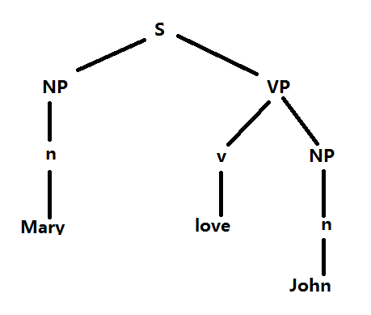
分析树

Slide 34
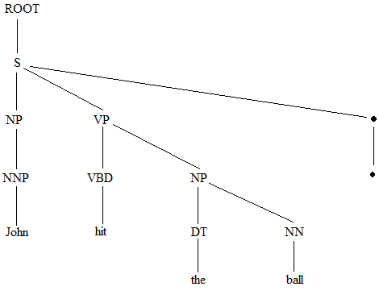
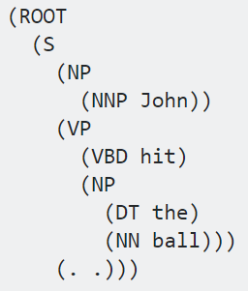
分析树的括号表示
(ROOT (S (NP (NNP John)) (VP (VBD hit) (NP (DT the) (NN ball))) (. .)))

Slide 35
Phrases and Handles
A sentential form is “derived” from the start symbol
Given a sentential form and its derivation, a phrase is the sequence of tokens descended from a nonterminal in the tree.
A direct phrase is the sequence of symbols derived directly from a nonterminal .
  a direct phrase is also called a simple or prime phrase because it contains no smaller phrase
The handle is the leftmost simple phrase. It is unique.
We will see the use of handle when we study LR parsing.
通过分析树，我们可以很容易地理解这些概念

Slide 36
use parse tree to your advantage
finding phrases, direct phrases, handles
baSb为句型baSb的相对于S的短语；
ba为句型baSb的相对于A的短语；
a为句型baSb的相对于B的短语,且为直接短语和句柄；
Sb为句型baSb的相对于B的短语,且为直接短语。
S
A
B
S
b
B
S
b
a

Slide 37
二义性（ambiguity）
A grammar, G, is said to be unambiguous if for all the sentence of L(G), there exists exactly one canonical derivation from S. Otherwise, G is said to be ambiguous.
E.g., Grammar:
E → E + E | E * E | ( E ) | id
Two parse trees for u = id + id * id

Slide 38
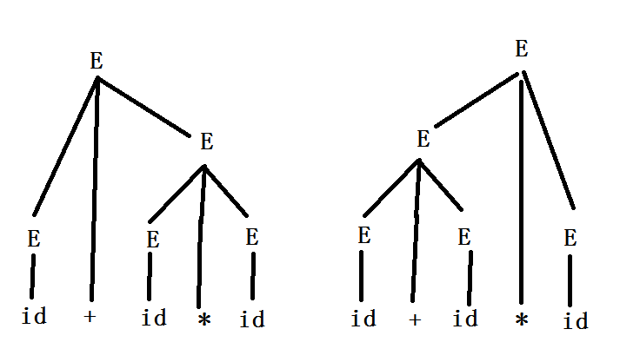
二义性（ambiguity）
分析树表示了优先级！

Slide 39
ambiguity
there is no algorithm to detect if a CFG is ambiguous, however, if a nonterminal is both left-recursive (that is, A=>⁺Aα) or right-recursive (that is, A=>⁺βA) , then this grammar is ambiguous:
A=>⁺βA =>⁺ βA α
A=>⁺A α =>⁺ βA α

Slide 40
ambiguity
ambiguous grammar can generate more than one parse tree (structurally different) for a sentence
ambiguity is undesired for compilers.
we can transform grammars to eliminate ambiguity
The original grammar must be equivalent to the new grammar

Slide 41
equivalence
two grammars are equivalent if they generate the same language
e.g. the following two grammars are equiv.
G1=({S},{a},{S→aSa|a},S)
G2=({S,A},{a},{S→aA|a, A→aS},S)
we can add, modify or delete rules to make a better but equivalent grammar

Slide 42
transform grammar
G[E]: E → i |E+E| E*E |(E)
将运算符的优先顺序和结合规则加到原有文法中(assume +,* is left associative and * has higher precedence)，则可构造无二义性的文法
G’[E]: E → T|E+T
T → F|T*F
F → （E）|i

Slide 43
The Infamous Dangling-Else Grammar
stmt → if ( expr ) stmt
  | if ( expr ) stmt else stmt
  | other
Solution: Introduce new non-terminals to distinguish matched then/else
stmt → matched_stmt | unmatched_stmt
matched_stmt → if ( expr ) matched_stmt else matched_stmt
  | other
unmatched_stmt → if ( expr ) stmt
| if ( expr ) matched_stmt else unmatched_stmt

Slide 44
eliminate left recursion
left recursion is problematic for recursive descent parsing. A left-recursive nontermintal can be changed to right-recursive:
A→Aα|β
can be changed to
A→βB
B→αB|ε
we will talk about this more in top-down parsing.

Slide 45
operations on languages
if language A is CF, B is also a CF, then the union of language A and B is a CF too.
how can we prove this？
if language A is CF, B is also a CF, then the intersection of language A and B is not necessary a CF.

Slide 46
用nltk來做句法分析
from nltk import CFG
grammar = CFG.fromstring("""
... S -> NP VP
... NP -> N
…VP -> V
…VP -> V NP
… N -> 'John'
... N -> 'Mary'
... V -> 'love'
... """)

Slide 47
用nltk來做句法分析
from nltk.parse import RecursiveDescentParser
rd = RecursiveDescentParser(grammar)
sentence1 = 'Mary love John'.split()
for t in rd.parse(sentence1):
... print(t)
輸出
(S (NP (N Mary)) (VP (V love) (NP (N John))))
也可以画出图形化的树：用t.draw()代替 print(t)即可
注意：nltk裡面有多種類型的句法分析器，RecursiveDescentParser
只是其中一種，還有ShiftReduceParser，各種chartparser，pcfg parser等，我們以後再介紹其原理。

Slide 48
Summary
key concepts:
formal grammar;sentence;sentential form;derivation;lm derivation;rm/canonical derivation;phrase;direct phrase;handle;
parse tree; ambiguity
Chomsky hierarchy; esp. CFG and RG

Slide 49
exercises
write down a grammar which generates the following language {a^{n}b^{n}|n<=4}. Is it a RG? a CFG?
what is language generated by the following grammar?
{S → aA , A → Sb , S → ε }
is it a regular grammar?
read http://en.wikipedia.org/wiki/Formal_grammar
http://tcno.net/doc/tor/

Slide 50
求句型i*i+i的短语和句柄
E
  G[E]：E→E+T|T
  T→T*F|F
  F→(E)|i
  句型：i*i+i
  短语：
  直接短语：
  句柄：
E
T
T
F
T
F
F
i
*
i
+
i

Slide 51
exercises
閱讀網頁 http://www.nltk.org/howto/parse.html

